Slide 1

BBC News Categorization and Clustering
By Natibundit Suntraranusorn

Slide 2



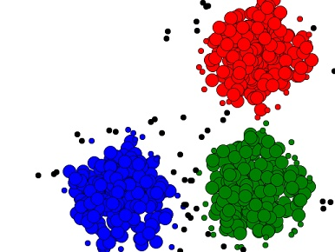
OVERVIEW SLIDE
2021
1.Dataset overview
2.Data exploration
3.Categorization
Data background
Words count and Words cloud
Naïve bayes, K-NN, Decision tree
4.Clustering
K-Means

Slide 3
1.Data overview
2021
Data background

Slide 4
Data background
2021
Original source
Sampling data
BBC news online.
Came from www.Kaggle.com
There is a notepad file
The number of files are 2,225 documents.
Consist of 5 categories that include Business, Entertainment, Politics, Sport and Technology.
BBC news online.
The sampling files are 900 documents.
randomly chosen 180 documents each subject.
(180*5 = 900)

Slide 5
2.Data exploration
2021
Boxplot, Words count and Word cloud

Slide 6

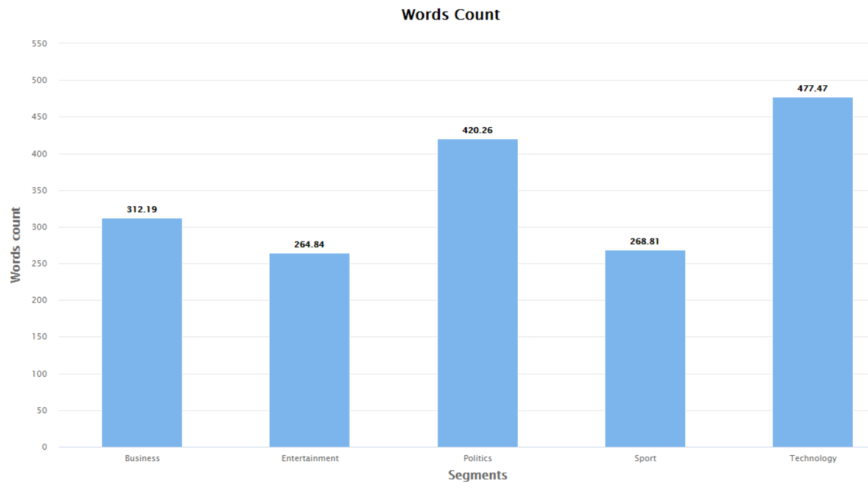
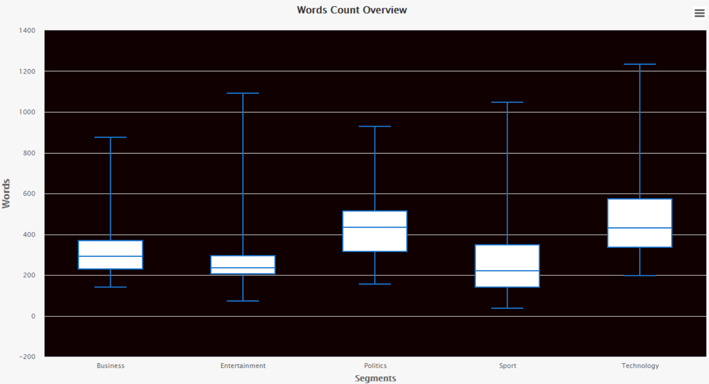
Words count
2021

Slide 7
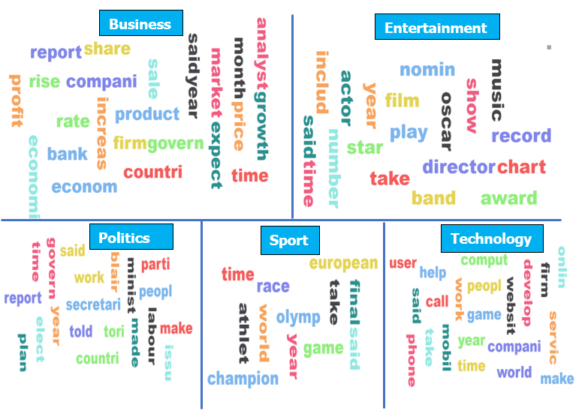
Words cloud
2021

Slide 8
3.Categorization
2021
Naïve bayes, K-NN, Decision tree

Slide 9
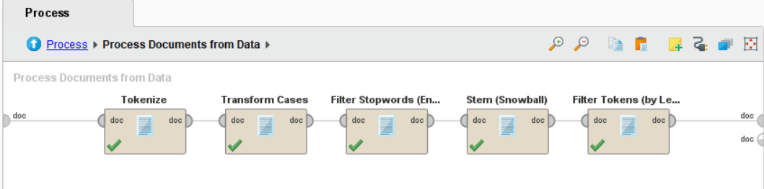
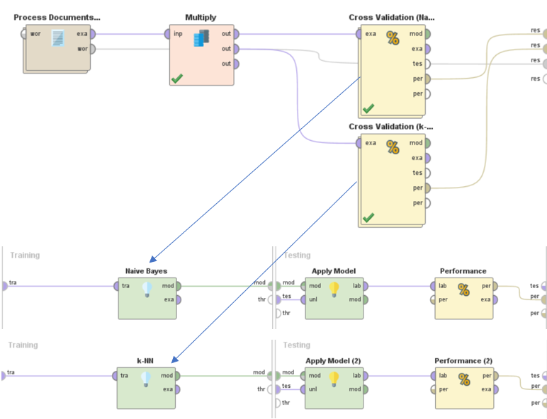

Data preprocessing and Apply model (Setting Default)
2021
K = 5

Slide 10
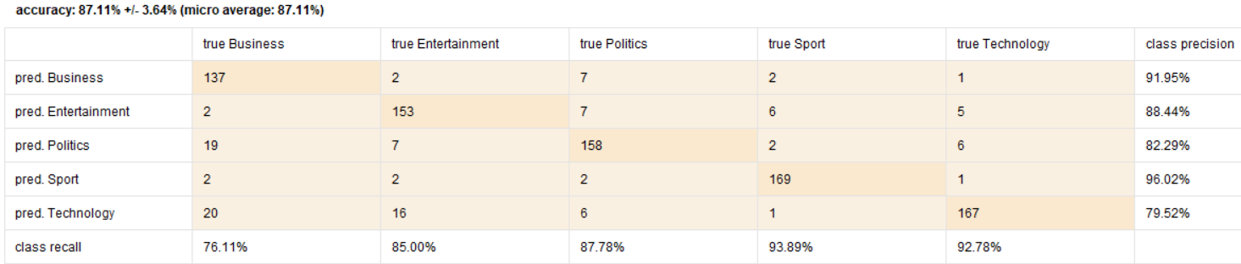
Naïve bayes
2021
Notes:
The result of both models is quite well performance, which Naïve Bayes has accuracy at 87.11%. However, there are some small incorrect predictions that predicted Politics but the truth is Business at 19 documents. Additionally, to predicted Technology but the truth are Business and Entertainment at 20 and 16 documents respectively.

Slide 11

K-NN
2021

Slide 12
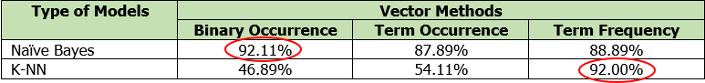
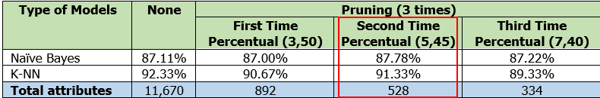
Tuning models
2021
Change vector creation model
Change Pruning
Naïve Bayes has the best accuracy at 92.11% with Binary Occurrence method, while K-NN has the best result at 92.00% With Term frequency Method. .
Rate conseris ma as dolupta idis aut apicide ruptatio.
Et expedis eossimpere mod mostinihil mo et.
Puditecte enimilluptae laboreri odi santotam as seque cor autem con restiistia volo.
the large number of attributes were dramatically reduced size from 11,670 to 528 attributes.
Notes:
Overall, Naïve Bayes has the best accuracy at 92.11% with Binary Occurrence method, while K-NN has the best result at 92.00% With Term frequency Method. Term frequency and TF-IDF have a similarly excellent result, which perform above 90%. However, TF-IDF is more suitable method because it considers the frequency number that was normalized value and the unique words that happen in specific documents. In other words, if the word has high frequent number and occur in less document, it will obtain high TF-IDF score.
Pruning TF-IDF was performed by setting pruning as a percentage by Creating 3 scenario. As a result of this test, all of three scenarios have a slightly different performance. However, the Second scenario prune by percentual for TF-IDF is lower than 5% and higher than 45%. As one can see, the large number of attributes were dramatically reduced size from 11,670 to 528 attributes but there is able to maintain the accuracy for both models, which increasingly improve an efficient time for running processes.

Slide 13
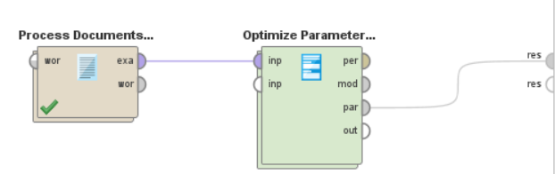
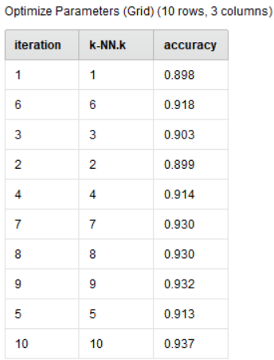
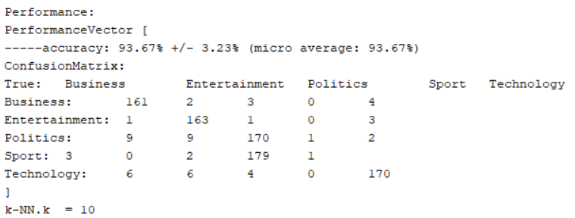
Tuning models
2021
Change Parameters
Adjust K-NN parameters.
Using Optimize Parameters (Grid) to find out the maximum accuracy.
K numbers change from 5 to 10. As a result, the accuracy was slightly increased from 91.33% to 93.67%.
Notes:
For K-NN, there is random choice K numbers 10 times to find out the optimum value by using Optimize Parameters (Grid). As a result, the accuracy was slightly adjusted from 92.33% to 93.67% when K numbers change from 5 to 10. It is possible that the data as the same group of the segment are adjacent to one another and it affect the result of accuracy.

Slide 14
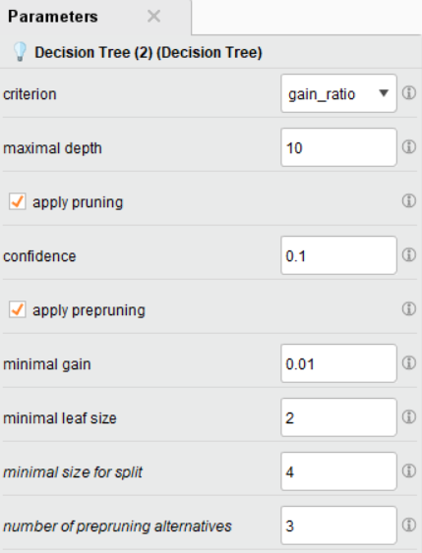
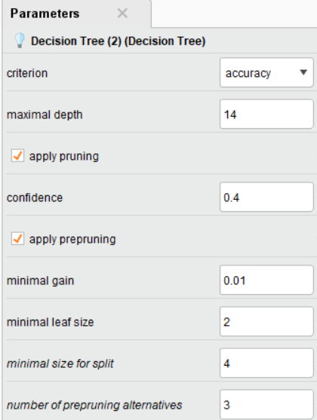
Tuning models Change model and tuning parameters
2021
Decision tree model (Setting default)
Decision tree model (Tuning parameter)
Default parameters
The accuracy is only 45.78%.
Change parameters
The accuracy substantially increase to 91.67%.
Notes:
Using Decision tree to classify the types of documents because this model easily understands the processing algorithm. For the first time, Decision tree model was set up as default parameters and using almost similar RapidMiner processes as before that show in the figure 13. As a result, Decision tree accuracy is only 45.78% that is obviously ineffective performance.
Subsequently, Decision tree was adjusted parameters, which use the optimize parameters (Grid) operation to improve the increasing accuracy that change criterion from gain ratio to accuracy, maximal depth and the confidence level. The type of criterion is significant effect to the result because business and politics labeled attributes were ignored to operate in Gain ratio criterion. Whereas, Accuracy criterion consider all of attributes with the most accurate performance. The result after adjustment is high accuracy which substantially increase from 45.78% to 91.67%.

Slide 15
4.Clustering
2021
K-Means

Slide 16
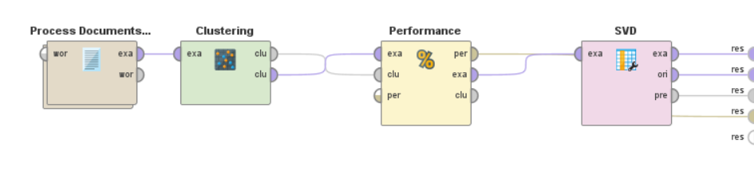
Data preprocessing and Apply model
2021
Notes:
The pre-processing method use the same operators as Classification Processes which include Transform cases (lowercase), Tokenize, Filter stop words (English), Stem (Porter) and Filter Tokens (by Length) that select the range of characters between 4 and 50 characters. For clustering process, the document vector was created by TF-IDF method and pruning of 5% bottom percentile and 45% top percentile. Moreover, each document vector was applied Single Value Decomposition (SVD) in order for better visualization of the clusters. Creating RapidMiner process by using K-Means with k = 5.

Slide 17
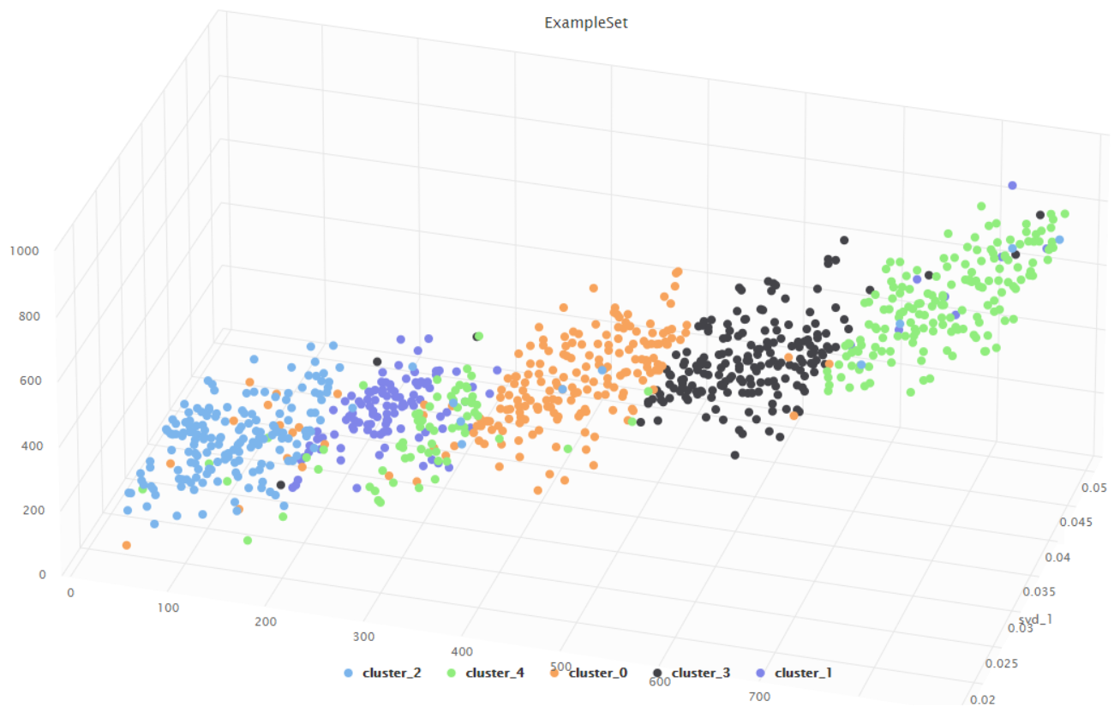
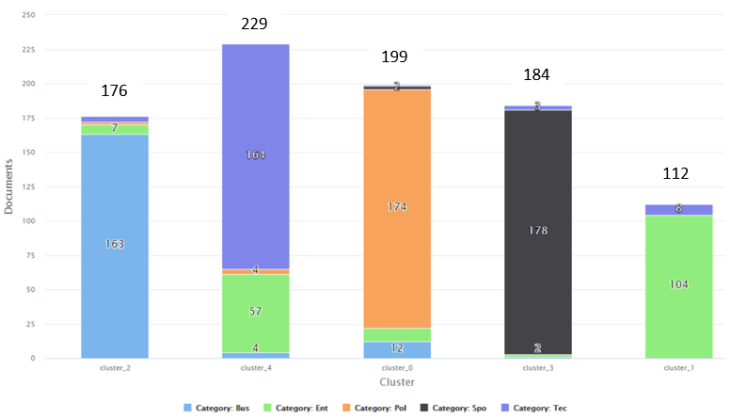
K-Means (k = default)
2021
Clustering using K-Means with k = 5
Type of document within each cluster

Slide 18
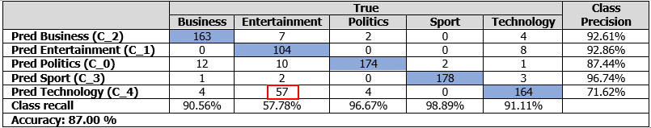
K-Means (k = default)
2021
Type of document within each cluster
Confusion Metrix
Notes:
According to figure 18 that have a major category for each cluster. Therefore, it was assumed that cluster_2 was represented in Business, cluster_4 was represented in Technology, etc. As a result, creating confusion matrix, was showed in table below, has accuracy at 87%. The major incorrect cluster is Cluster_4 that has the number of Technology at 57 documents should be clustered in Cluster_1.

Slide 19
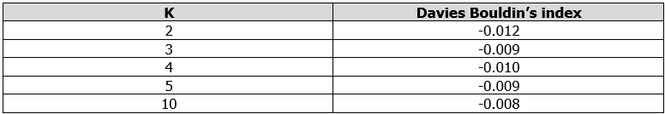
Tuning models
2021
Devies Bouldin’s index
the less Davies Bouldin’s number than -0.009 or k = 5 are k = 2 and 4.
Notes:
In comparison with the Davies Bouldin’s number in this table below, the less Davies Bouldin’s number than -0.009 or k = 5 are k = 2 and 4. Therefore, creating K-Means with k = 2 and 4 to see the clustering image in figure 19 and figure 20.

Slide 20
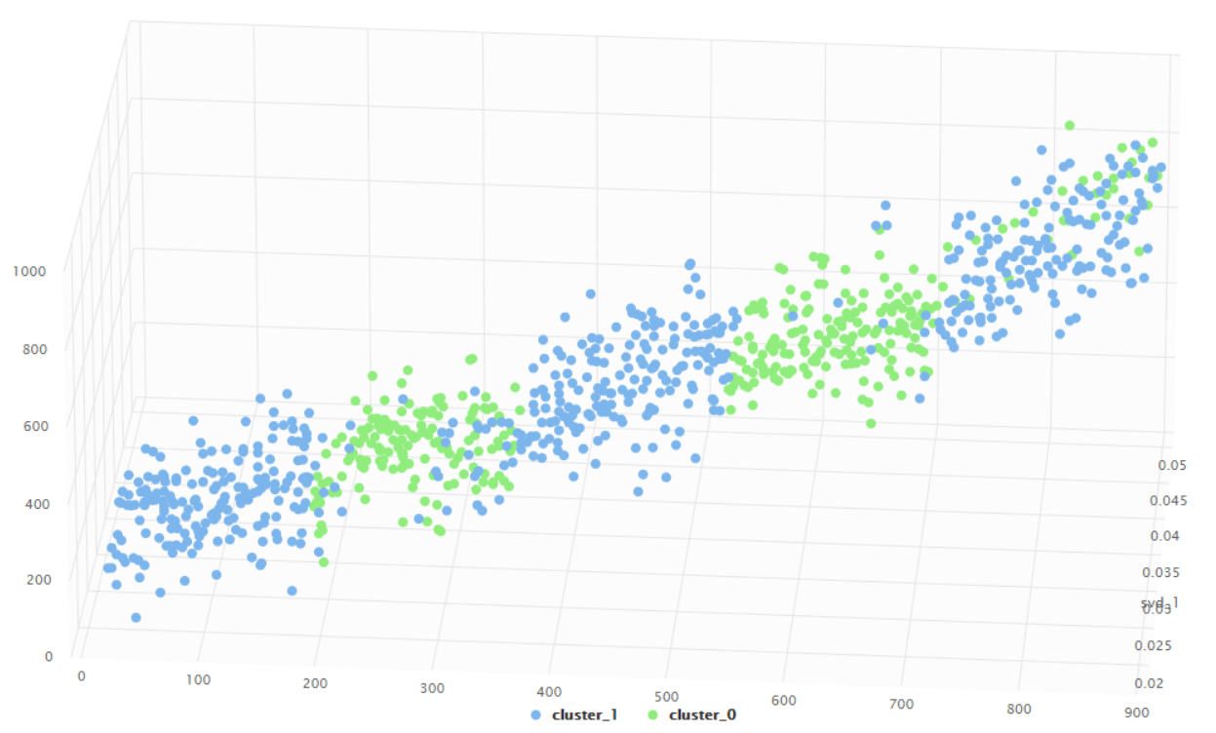
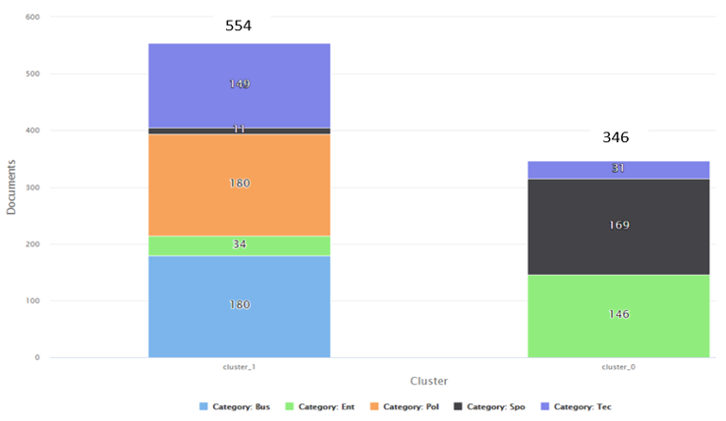
Tuning models (k = 2)
2021
Clustering using K-Means with k = 2
Type of document within each cluster
Notes:
As one can see in figure 19, Business, Politics and Technology were integrated at the first group. On the other hand, Entertainment and Sport are at the second group. It might have probability that key words were used in the business, politics and technology documents are more similar than the key words in the second group. In figure 20, the cluster_3 was contained by Business and Technology documents that have a slightly different amount of both categories and they are a major proportion for this cluster.

Slide 21
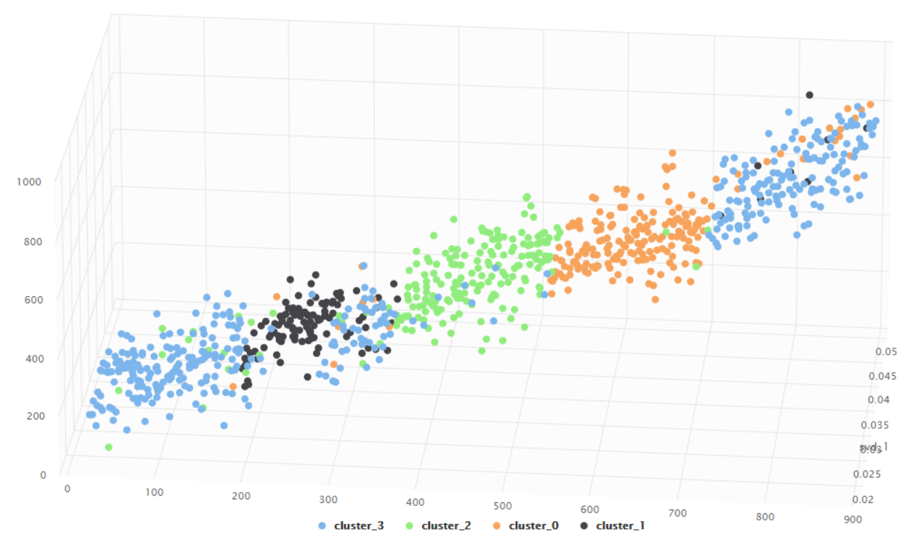
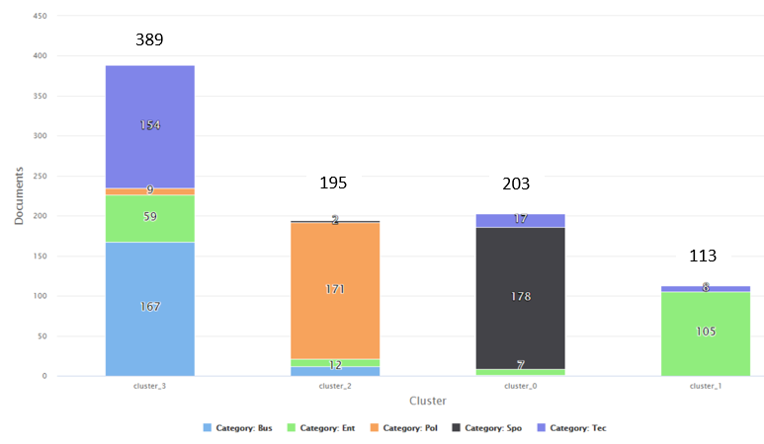
Tuning models (k = 4)
2021
Clustering using K-Means with k = 4
Type of document within each cluster
Notes:
Overall, the appropriate number of clusters is k = 5 which obviously see the pattern of data point in the scatter plot. And, in fact the original dataset was come from BBC news online in 5 categories. It might be that each categories had the unique words that can represent a cluster of its own.

Slide 22

Conclusion
2021
From my point of view, classification model (K-NN) has a greater result at 93.67% and more flexible to adjust the model in comparison with clustering model (K-NN) at 87%

Slide 23
THANK YOU!
2021

